Slide 1

Statistics, an unreliable friend
Magnus Ahlkvist

Slide 2
About Magnus
Magnus Ahlkvist
Transmokopter SQL AB – database consultant
Abbreviations.

Slide 3
Session contents (Not necessarily in this order…)
Ascending key
Missing key
Statistics
Case study

Slide 4
Why did I make this presentation?
System for reporting financial statistics
Tight deadline
Bad performance on reporting day => Reporting done late => ECB unhappy => DBA being yelled at => I’m unhappy

Slide 5
Session scenario
Order system
Ship orders to warehouse system
All good. Until not good.

Slide 6
Problem specifics
Getting orders for yesterday and before => Fast
Getting today’s orders => Not fast

Slide 7
DEMO

Slide 8

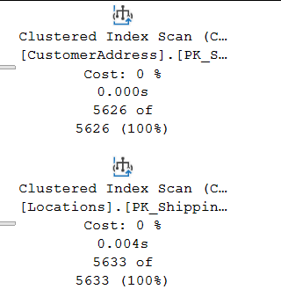
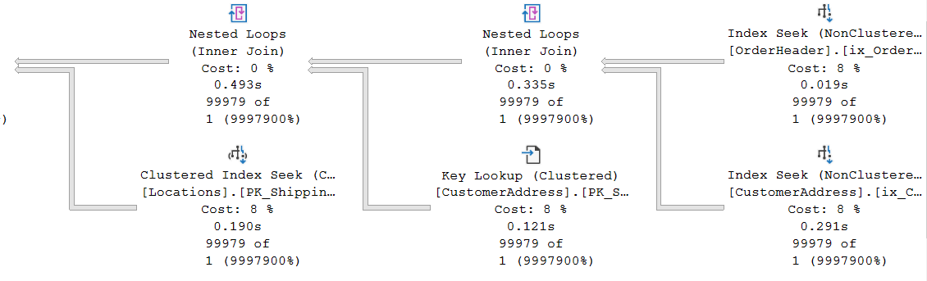
Some plan characteristics
OK
Awful

Slide 9
Hey Mr DBA
Ola Hallengren’s maintenance solution, run nightly

Slide 10
DBCC SHOW_STATISTICS
DEMO

Slide 11
Statistics histogram
RANGE_HI_KEY | RANGE_ROWS | EQ_ROWS | DISTINCT_RANGE_ROWS | AVG_RANGE_ROWS
Upper limit of a bucket (sqlvariant). A distinct value from the leading column in the index/statistics object. | Number of rows in the bucket, smaller/lower than the value of RANGE_HI_KEY | Number of rows in the bucket with value exactly RANGE_HI_KEY | Number of unique values for the leading column of the index/statistics object in the bucket | Average rows per distinct value within the bucket

Slide 12
Density vector
Density of leading column, then two leading columns in combination, then three leading columns…
Density = 1 / NoDistinctValues
Gender = High density, SSN = Low density
Low Selectivity = High Density

Slide 13
Estimated number of rows
With histogram
OrderDate = 2016-08-24: 99988
OrderDate = 2016-08-25: 0 (Optimizer will estimate 1)
With Density Vector
D = Density for column(s) involved in equality predicate.
Example: OrderDate = 2020-08-25. Density for OrderDate = 0,02
RC = Total number of rows in the table
Estimated number of rows for equality predicate: D * RC
2020-08-24: 0,02 x 4 999 400 = 99 988
2020-08-25: 0,02 x 4 999 400 = 99 988

Slide 14
Ascending Key Problem
Can also be missing key-in-the-middle problem

Slide 15
Let’s try to fix it
DEMO

Slide 16
Is there a silver bullet?
…or is it ”It depends”?

Slide 17
Other causes of bad guessing on Optimizer part
Statistics updated with low sample rate and skewed data
Bad cardinality estimation due to complex predicate and join logic
SQL 2014 and later addresses Ascending Key (with varying success)
But introduce a new cardinality estimator
DEMO

